Slide 1

Welcome to Tylers Green First School
Reception 2025

Slide 2
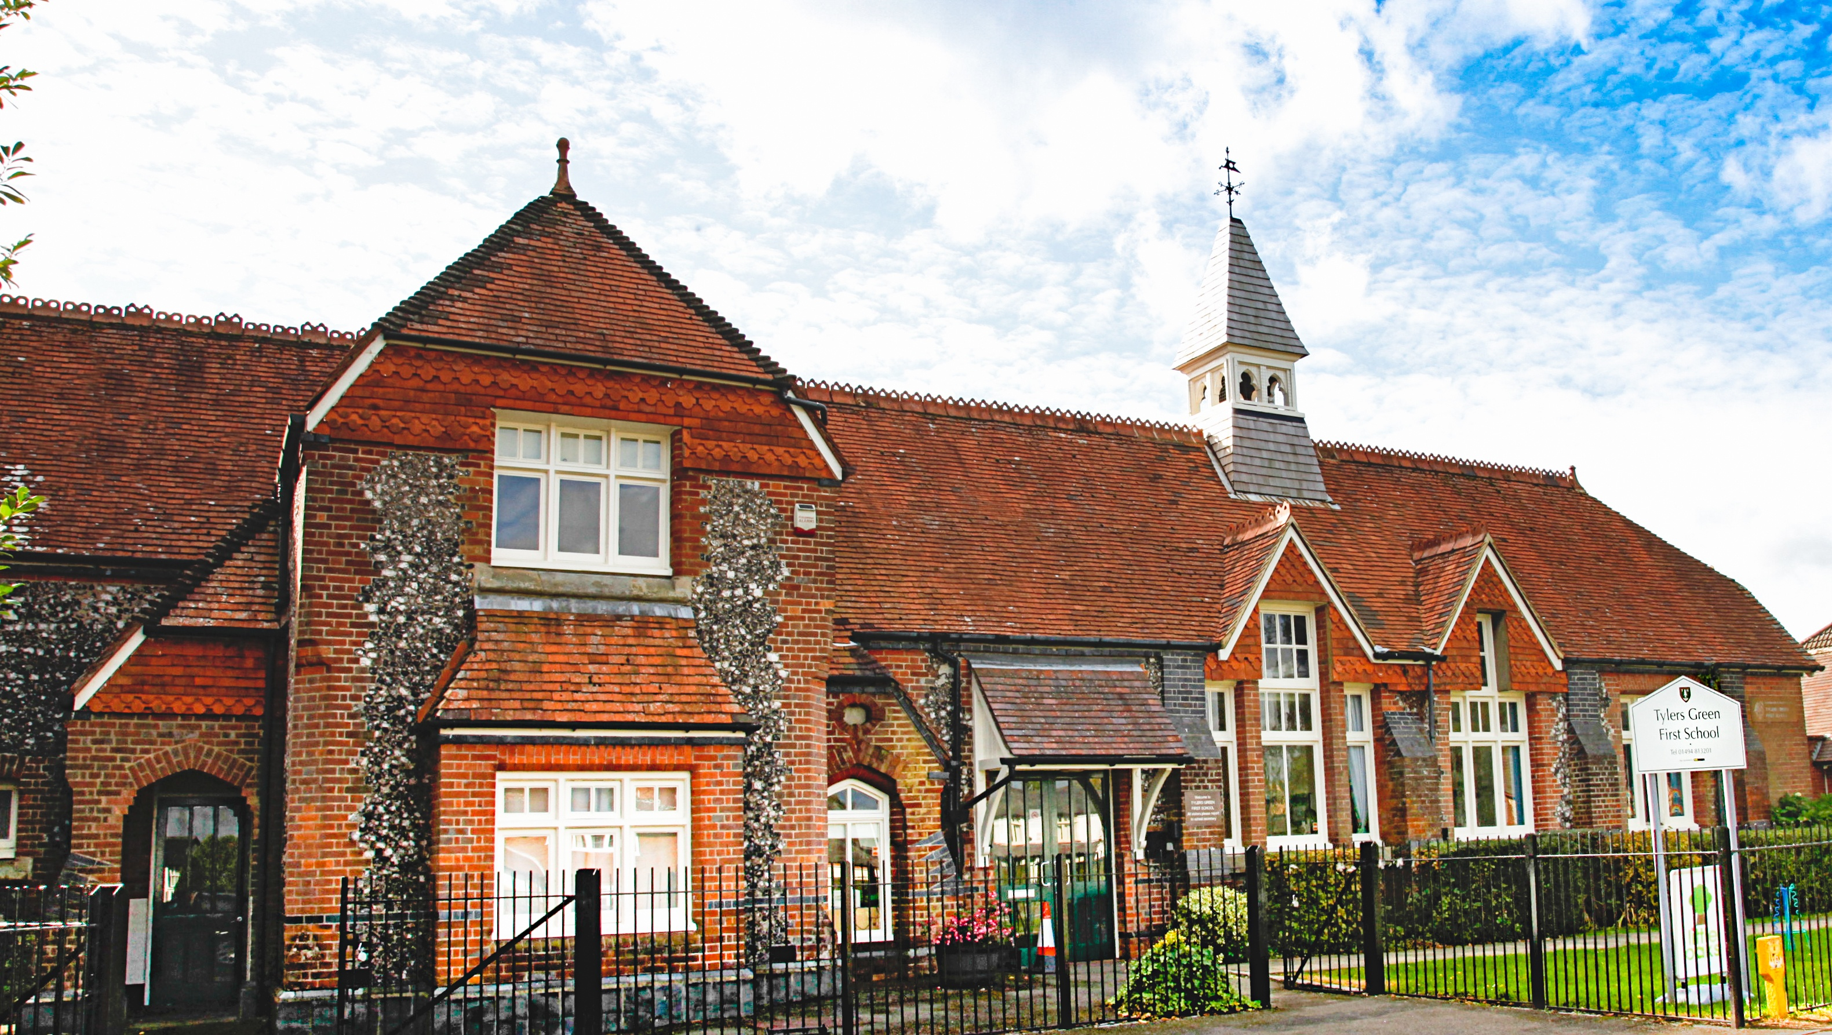
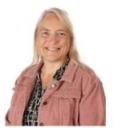
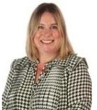
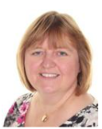
Key staff members – who to contact
Mrs Talbot – Headteacher. Any concerns or questions around safety, school policies, the curriculum, school rules, or general worries! Mrs Talbot is usually on the gate daily or can be contacted via phone or email.​​​
Ms Gregory – SENCO and DHT. Any worries or concerns about special needs, medical needs, disability, diversity, support in class or general worries around children's progress.​
Mrs Turner - PA to Headteacher. School meals, dates and times, administrative queries.
Mrs Beevers
Parent Governor.
To give feedback on policies and governance.

Slide 3
Our philosophy:
The child at the heart of the school, the school at the heart of the village

Slide 4
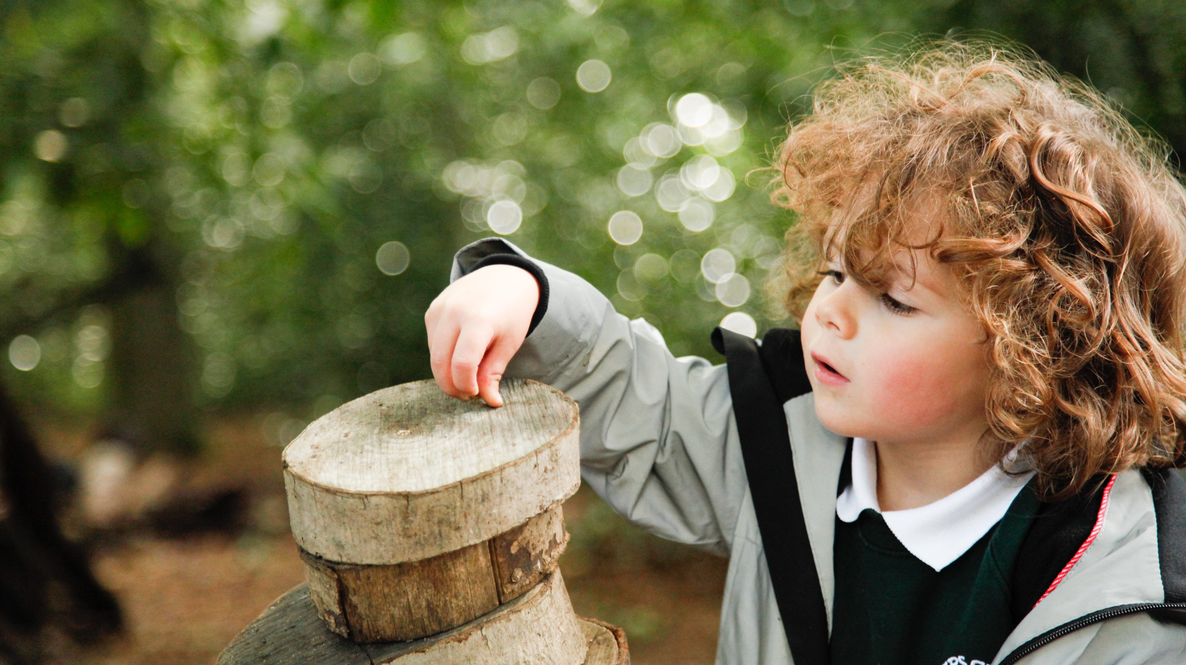
Our School Values – Safe, Happy, Learning, Creative and Successful

Slide 5

School Rules – written by our School Council
Be Safe
Be Kind
Do your best
Listen to grown ups
Look after our school

Slide 6
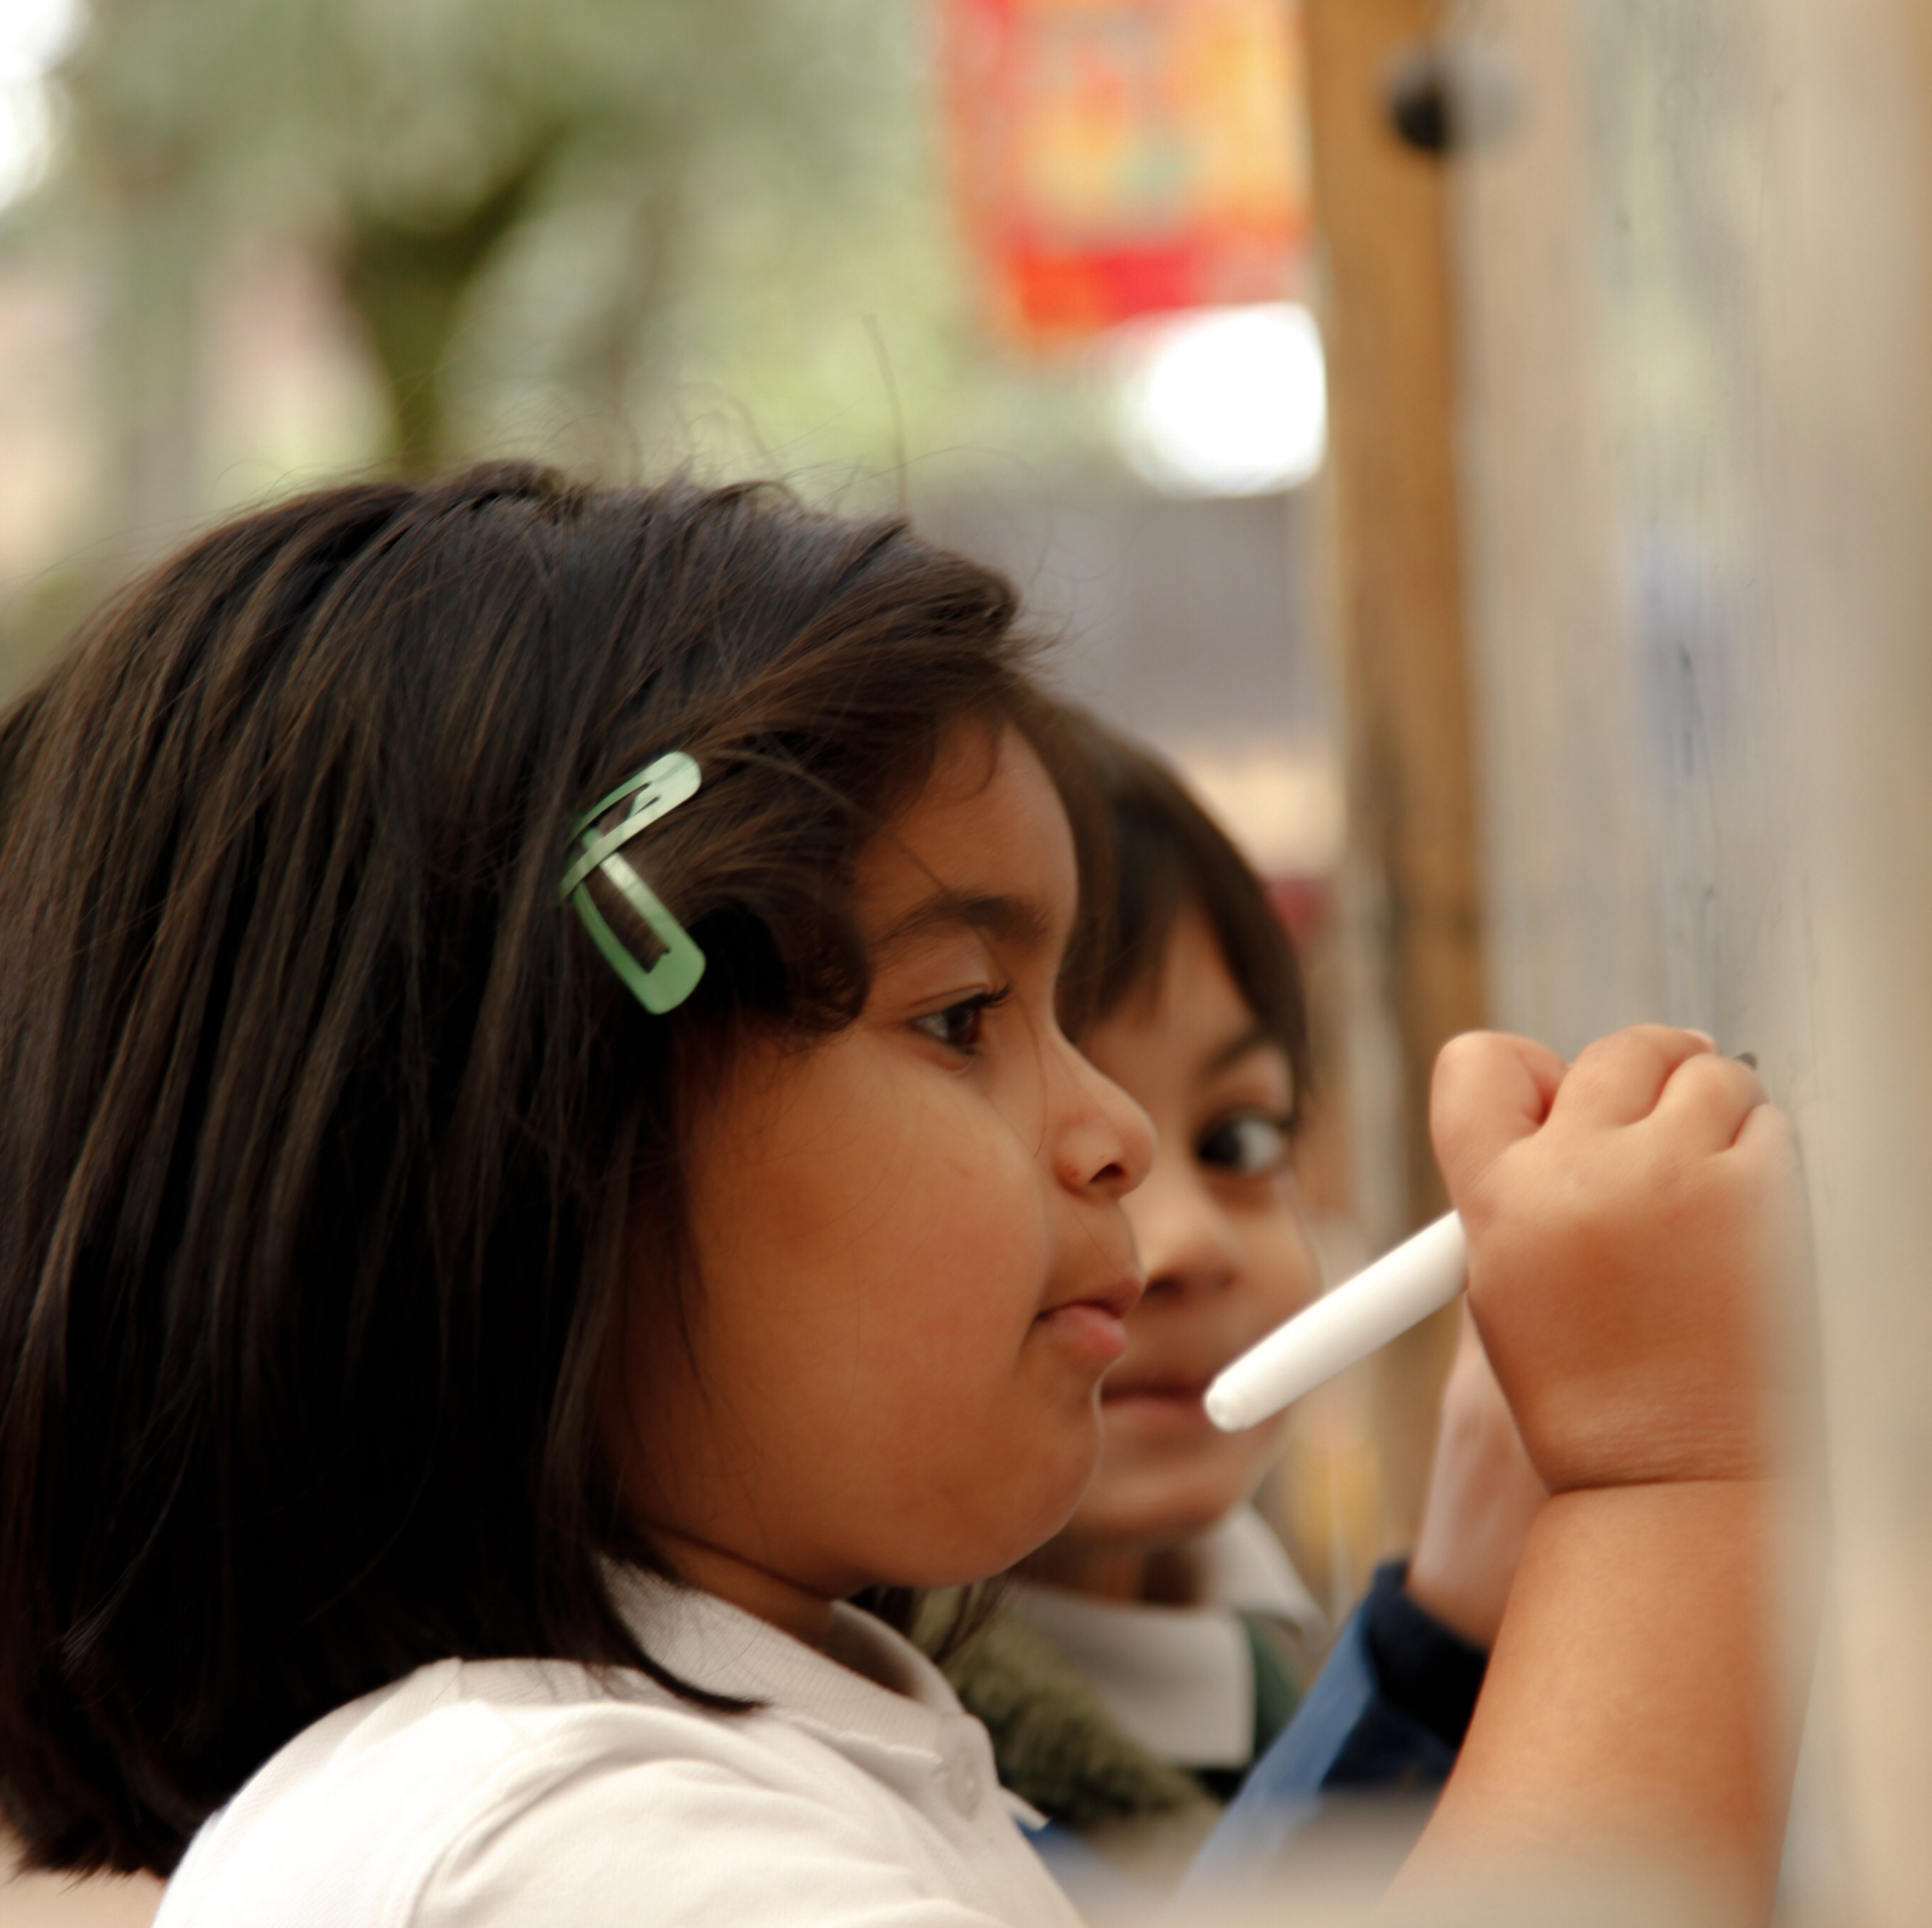
Early Reading and Phonics
A sound grasp of phonics will help your child learn to read and write
Reception is where the bulk of the new learning happens
Helpful information on the school website.
We use Bug Club Phonics
Please read with your child every day and practice their letter sounds. The best 10 minutes of your day!

Slide 7

Parking – the most talked about topic in school!

Slide 8

Questions or worries?
Email office@tgfs.org.uk - we will check emails regularly during the holidays
Call us on 01494 813201 until the 23rd July or after the 3rd of September.

Slide 9
Welcome to Reception at Tylers Green First School

Slide 10
Your welcome packs
You should have been given a pack of information on your way in this afternoon.
  Information about which class your child will be in and who their teacher(s) will be.
  Tapestry permission – for us to take photos of your child for you to see at home. Please return this as soon as possible so we can start setting this up ready for September.
  Cool Milk leaflet
  White card - who your child will be going home with
  ParentPay leaflet
  Parking Map
  Frequently asked questions
  Term Dates
  Leave of absence leaflet
  Teaching your child to read at TGFS booklet
  Home School Agreement Letter and Form
  Brown envelope with medical forms. If your child has medical needs and you do not have a brown envelope, please speak to Mrs Turner in the office.

Slide 11
A little bit about the class lists
We're often asked how we divide the children into the two classes:
We receive our list of children after the Easter holidays
Mrs Turner starts to send information out to new families and begins collating returned forms/acceptance/rejections etc.
Mrs Hamilton starts contacting pre-schools to find out as much as we possibly can about every child.
Reception teachers try to visit as many pre-schools as possible so the children get a chance to meet one of their teachers and so we can chat with their key-workers about any specific needs.
Mrs Hamilton reads through each childs 'Getting to Know You' form (again to find out as much about each child as possible).
As we receive forms back from parents, Mrs Turner updates our spreadsheet with any medical conditions, allergies etc.
Mrs Hamilton divides the classes, ensuring that there is an even split of girls/boys, ages and needs.
Mrs Talbot checks the list and approves it
We are currently full – we have 30 children in each class.

Slide 12
Our induction programme
Individual visits – Friday 5th September - Wednesday 10th September
Stay and Play sessions – Wednesday 10th September PM, Thursday 11th September AM & Thursday 11th September PM
Morning sessions to 1pm
Half class – Friday 12th September to 1pm
Half class – Monday 15th September to 1pm
Whole class – Tuesday 16th September to 1pm
From Wednesday 17th September children will stay all day to 3.10
*Packed lunch will be required for the first couple of weeks

Slide 13

Why do we do it?
School
Maslow’s Hierarchy of Need

Slide 14
A little bit about self regulation
Self-regulation refers to a person’s ability to understand and manage their behaviour and reactions to the feelings they are experiencing. It includes being able to control impulses, calm down after experiencing something exciting or upsetting and being able to behave in socially appropriate ways.
Self-regulation is now recognised as crucially important in young children’s development, strongly predicting children’s later success in relating to others and in their learning, while supporting lifelong mental and physical health.
Developing self-regulation, like many elements of development and learning, is not something children do by themselves. It is a process that grows out of attuned relationships where the caregiver and child are closely attentive to each other and engage in sensitive, responsive exchanges. We can only support your child to self-regulate if they have formed good relationships with us and feel safe, secure and valued.
Having a good relationship with your children, creating secure attachments will mean that your children are more engaged, independent, curious, confident and resilient – all crucially important to ensure success at school.

Slide 15
The results speak for themselves...
End of Reception data last year
GLD – 83% (nationwide average was 67%)
ELG Reading - 83%
ELG Writing - 90%
ELG - Number - 93%

Slide 16
Our timetable
 | 8:40-8.50 | 8.50-9.10 | 9.10-10:15 | 10.15-10.45 | 10.45-11.45 | 11.45-1.00 | 1-2.40 | 2:40-3:10
Monday | Registration | Phoni cs | Reading/writing | Play | Maths | LUNCH | Name writing practice Gross motor exercises Fine motor/theraputty PE from January | Story and home time
Tuesday |  |  | Reading/writing | Play | Maths |  | Child initiated learning in 3 inside rooms and 1 outside area.
Wednesday |  |  | Music Jigsaw | Play | Music Jigsaw |  | Child initiated learning in 3 inside rooms and 1 outside area.
Thursday |  |  | Reading/writing | Play | Maths |  | Child initiated learning in 3 inside rooms and 1 outside area.
Friday |  |  | Reading/writing | Play | Maths |  | Child initiated learning in 3 inside rooms and 1 outside area.

Slide 17
In September
There will be further information in September about what we will be learning and how we teach including:
Bug Club Phonics – our phonics/reading programme
Reading/writing
Maths
Jigsaw
Child initiated learning

Slide 18
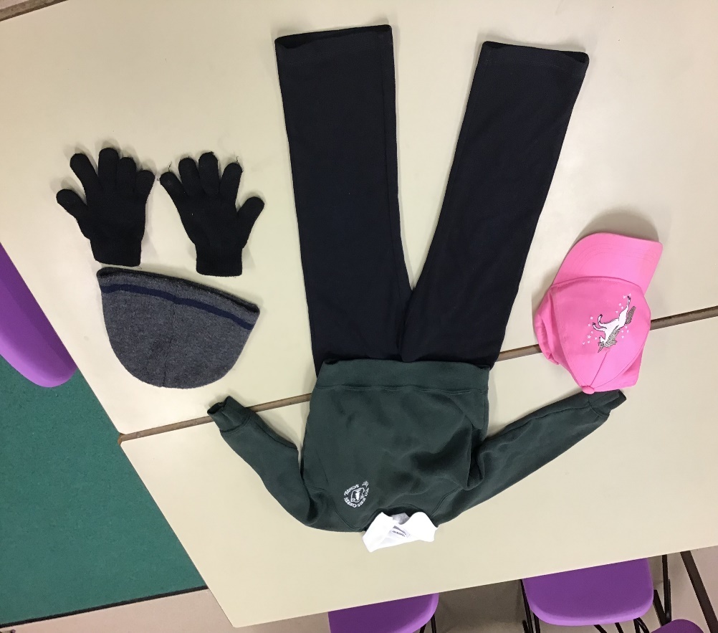
Our Uniform
Black jogging bottoms or leggings
White polo shirt
Bottle Green sweatshirt or cardigan
Sturdy black shoes that cover the whole foot (no laces please)
Wellies (to be kept in school)
No skirts, dresses or shorts please
Summer uniform
Black PE shorts to be kept in school for hot days
Sun hat
Waterproof coat
Suncream to be applied before school
Winter uniform
Warm waterproof coat every day
Hat & gloves (not scarves)
Warmer wellies (optional)
PLEASE NAME EVERYTHING!
PE Kit
Black shorts, white t-shirt, black plimsoles (in a bag)

Slide 19
What we would like from the children
Parents and pre-schools often ask us what we would like the children to be able to do by the time they join us in September. Here’s our top 10 list of things we would like your child to be able to do. Of course, all children develop at their own rate and some children, particularly summer born children may not be able to do everything on the list:
Wipe their own bottom.
Put their coat on, including being able to pull the sleeves through.
Put their wellies and shoes on by themselves.
Take their sweatshirt off independently and pull the sleeves through.
Use a knife and fork to cut their food.
Listen to and follow simple instructions.
Be able to communicate their needs.
Share toys and take turns.
Understand why letters and numbers are important.
Be able to hold a pencil and have the necessary control to form recognisable letters.

Slide 20
What we would like from parents
One of our greatest strengths at Tylers Green First School is our relationship with parents. Our induction programme is designed for us to form strong relationships with the children, but we also want to develop good relationships with parents, so you all feel confident to come and talk to us when you have questions or concerns. We would like our parents to:
Talk to us if you have any questions or concerns.
Be present when you drop off/pick up from school – please put your phone down and ask your child about their day.
Read a bedtime story to your child EVERY DAY! As well as being the best part of the day, reading stories with your children daily is another great predictor of educational success. Stories on a tablet or TV are not the same.
Sing/say nursery rhymes with your child regularly – children who know 8 nursery rhymes by the time they are 4 are usually among the best readers when they are 8.
Talk to your children – communication and language is one of the most important areas of our curriculum.

Slide 21
What we would like from parents
Play board games – they teach turn taking, sharing, counting and are great for communication and language
When we start assigning games and/or books on Bug Club, please log in every day and spend 10 minutes practicing sounds and blending.
Read correspondence from school. Most communication from us will come in emails. Please read them, make sure you know when term starts and ends and if we have an early finish. Also read our weekly newsletters for learning for the week and reminders. If you have a question, look on our website first. Most answers can be found easily. If not, ask Mrs Turner or your child's teacher/TA
Toilet train your child. If they are still in nappies/pull ups, please work on it over the summer holidays. We do not have staff to change nappies.
Teach your children to dress and undress themselves. In September they will need to be able to put their coats on, take off sweatshirts and change shoes/wellies. From January they will need to be able to dress/undress for PE. We are there to help but we cannot dress 30 children every day.
Teach your children how to use a knife and fork to cut their food. We are there to help, not do it for them.

Slide 22
Name everything
Name everything
Name everything
Please remember that we are always here if you have any questions or anything that you’re concerned about. You can contact us through the office email or give us a call.
We are looking forward to seeing you and your child on Tuesday for induction afternoon.
Name everything
Name everything
Name everything
Name everything
Name everything
Name everything

