Slide 1

Welcome to Tylers Green First School
Reception 2026

Slide 2
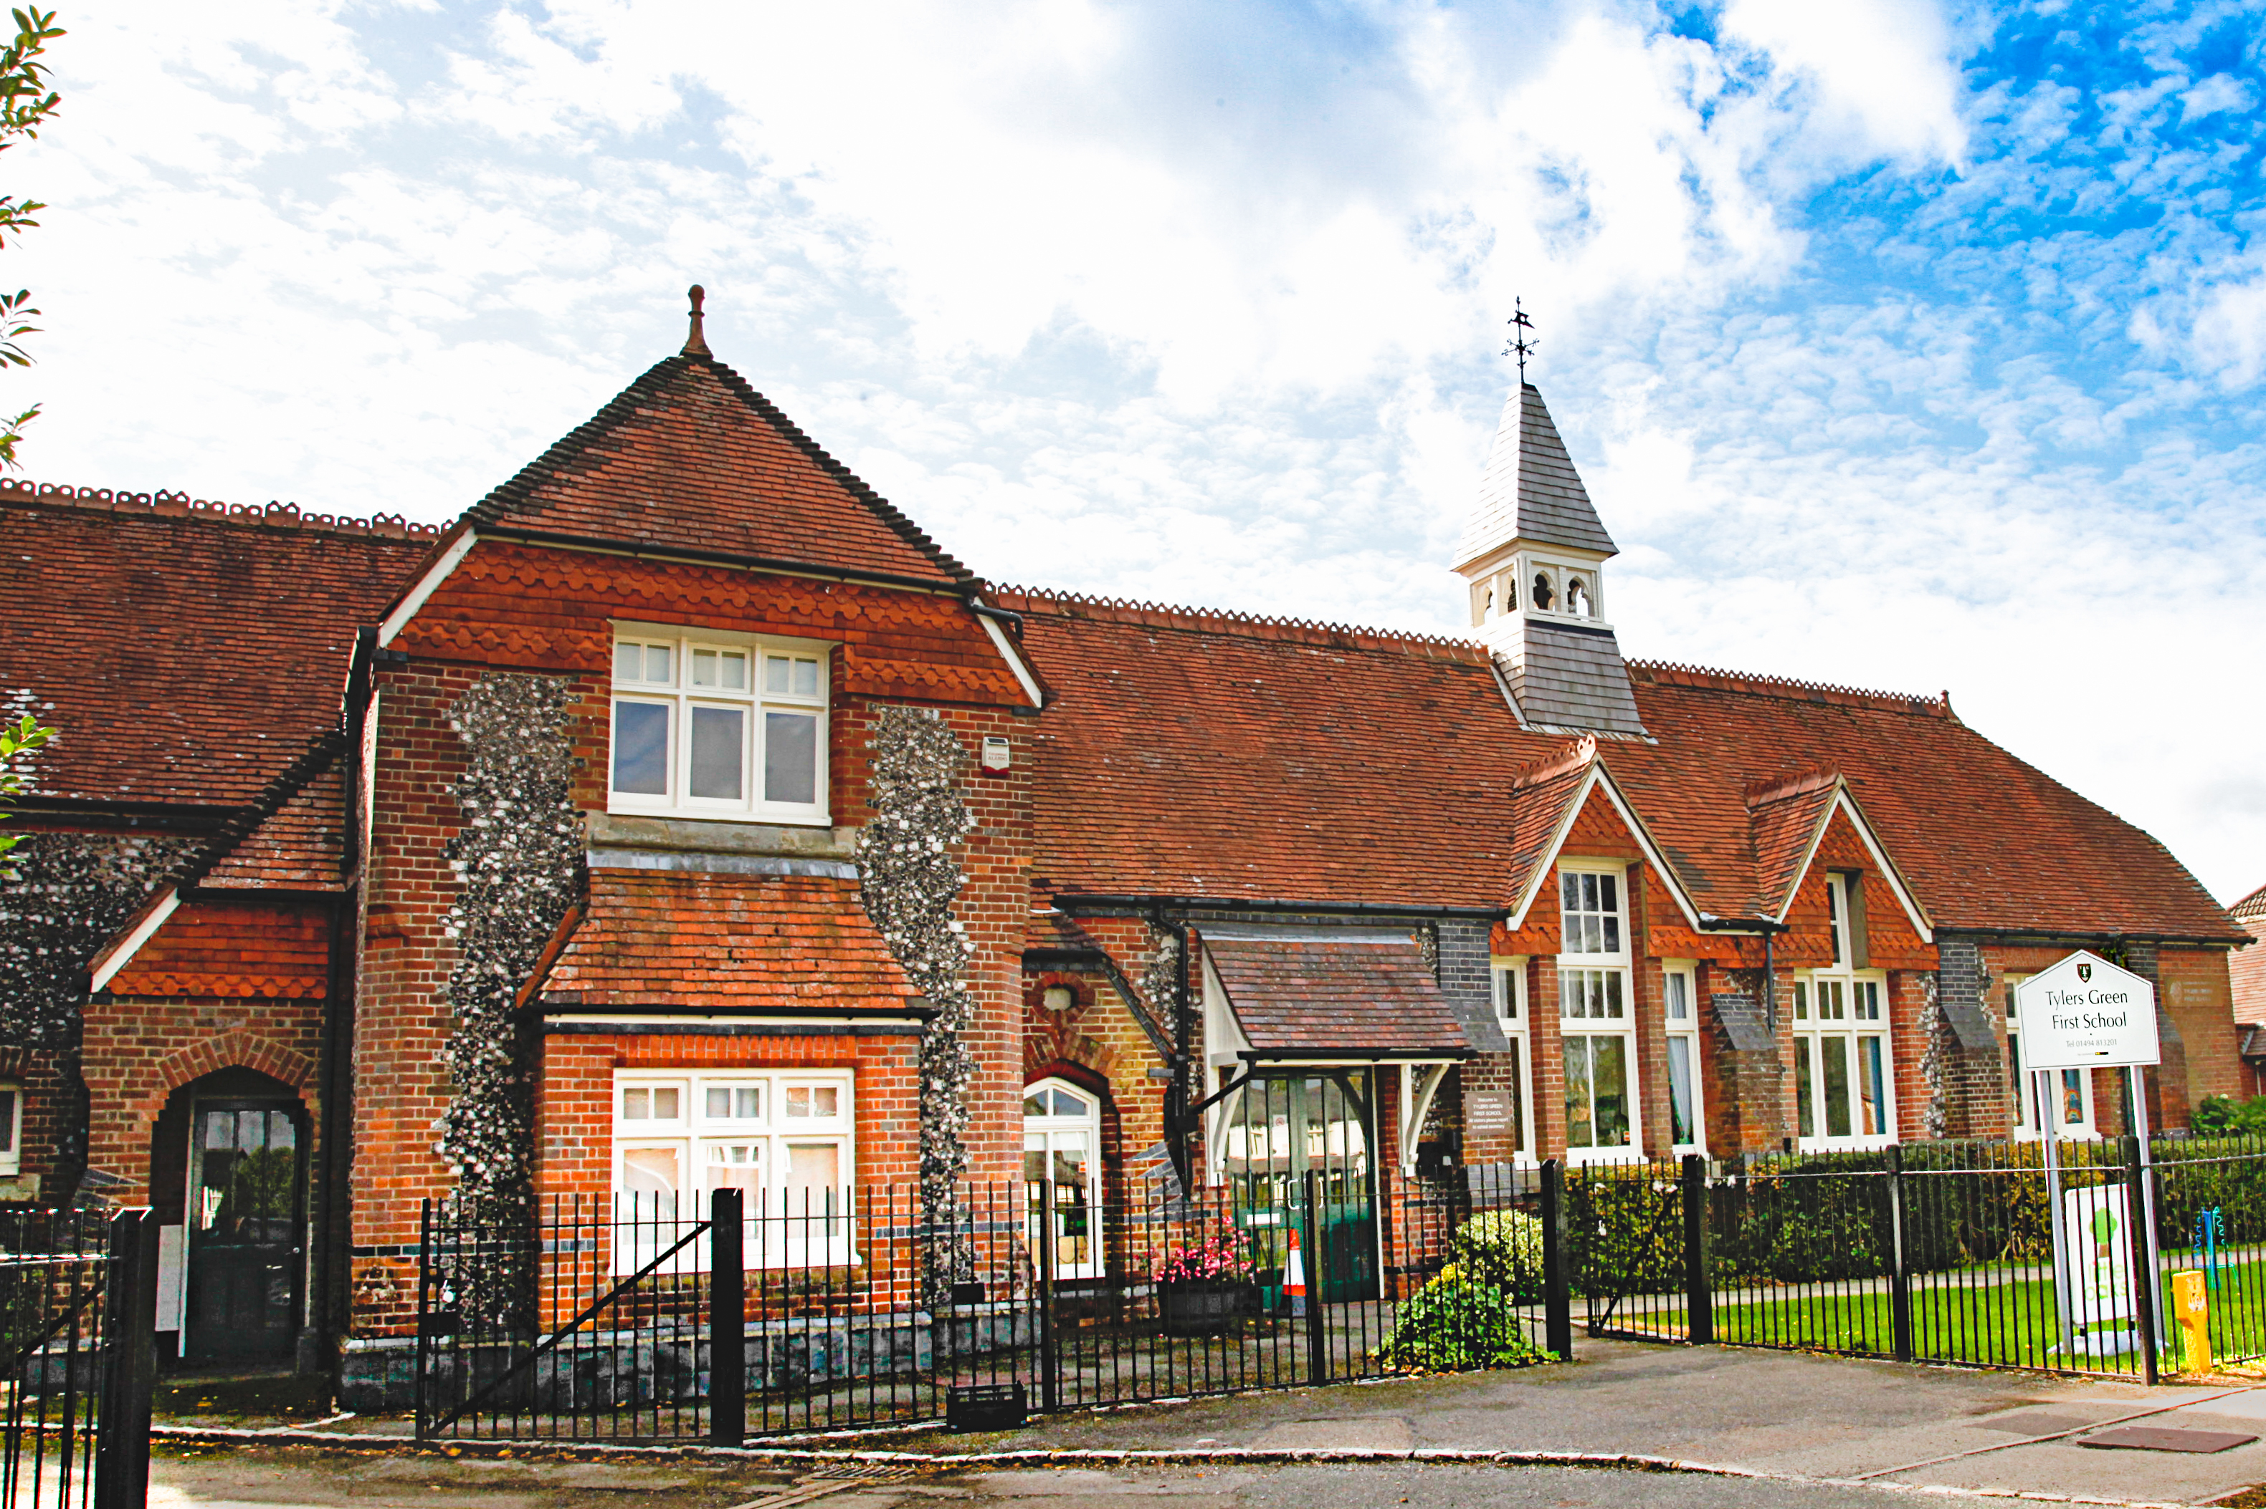
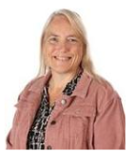
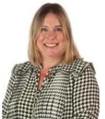
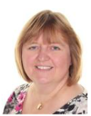
Key staff members – who to contact
Mrs Talbot – Headteacher. Any concerns or questions around safety, school policies, the curriculum, school rules, or general worries! Mrs Talbot is usually on the gate daily or can be contacted via phone or email.​​​
Ms Gregory – SENCO and AHT. Any worries or concerns about special needs, medical needs, disability, diversity, support in class or general worries around children's progress.​
Mrs Turner - PA to Headteacher. School meals, dates and times, administrative queries.
Mrs Beevers. Parent Governors.
To give feedback on policies and governance.

Slide 3

Parking – the most talked about topic in school!

Slide 4

Questions or worries?
Email office@tgfs.org.uk - we will check emails regularly during the holidays
Call us on 01494 813201 until the 20th July or after the 6th September.

Slide 5
Your welcome packs
You should have been given a pack of information on your way in this afternoon.
This should be mostly self-explanatory but we would like to draw your attention to a few things:
  Information about which class your child will be in and who their teacher(s) will be + dates for September.
  Tapestry permission – for us to take photos of your child for you to see at home
  Cool Milk leaflet
  ParentPay leaflet
  White Card
  Parking Map
  Frequently asked questions
  Term Dates
  Leave of absence leaflet
  Teaching your child to read at TGFS booklet
  Home School Agreement Letter and Form
  Pupil premium forms
  Starting Reception & potty training guides

Slide 6
Our induction programme
Individual visits – Thursday 3rd – Tuesday 8th September
Stay and Play sessions – Tuesday 8th September PM, Wednesday 9th September AM & PM
Morning sessions 8.40 to 1pm (gates open at 8.35)
Half class – Thursday 10th September
Half class – Friday 11th September
Whole class – Monday 14th September
Whole day 8.40 to 3.10 (gates open at 8.35)
From Tuesday 15th September

Slide 7

Why do we do it?
School
Maslow’s Hierarchy of Need

Slide 8
A little bit about self regulation
Self-regulation refers to a person’s ability to understand and manage their behaviour and reactions to the feelings they are experiencing. It includes being able to control impulses, calm down after experiencing something exciting or upsetting and being able to behave in socially appropriate ways.
Self-regulation is now recognised as crucially important in young children’s development, strongly predicting children’s later success in relating to others and in their learning, while supporting lifelong mental and physical health.
Developing self-regulation, like many elements of development and learning, is not something children do by themselves. It is a process that grows out of attuned relationships where the caregiver and child are closely attentive to each other and engage in sensitive, responsive exchanges. We can only support your child to self-regulate if they have formed good relationships with us and feel safe, secure and valued.
Having a good relationship with your children, creating secure attachments will mean that your children are more engaged, independent, curious, confident and resilient – all crucially important to ensure success at school.

Slide 9
Our timetable
 | 8:40-8.50 | 8.50-9.10 | 9.10-10:15 | 10.15-10.45 | 10.45-11.45 | 11.45-1.00 | 1-2.40 | 2:40-3:10
Monday | Name writing/Registration | Phonics | Sound of the day/ Drawing Club | Play | Maths | LUNCH | Name writing practice Gross motor exercises Fine motor/theraputty Music | Story and home time
Tuesday |  |  | Sound of the day/ Drawing Club | Play | Jigsaw |  | Child initiated learning in 3 inside rooms and 1 outside area.
Wednesday |  |  | Sound of the day/ Drawing Club | Play | Maths |  | Child initiated learning in 3 inside rooms and 1 outside area.
Thursday |  |  | Sound of the day/ Drawing Club | Play | Maths |  | Child initiated learning in 3 inside rooms and 1 outside area.
Friday |  |  | Sound of the day/ Drawing Club | Play | Maths |  | Child initiated learning in 3 inside rooms and 1 outside area.

Slide 10
In September
There will be further information in September about what we will be learning and how we teach including:
Bug Phonics – our phonics/reading programme
Drawing Club
Maths
Jigsaw
Child initiated learning

Slide 11
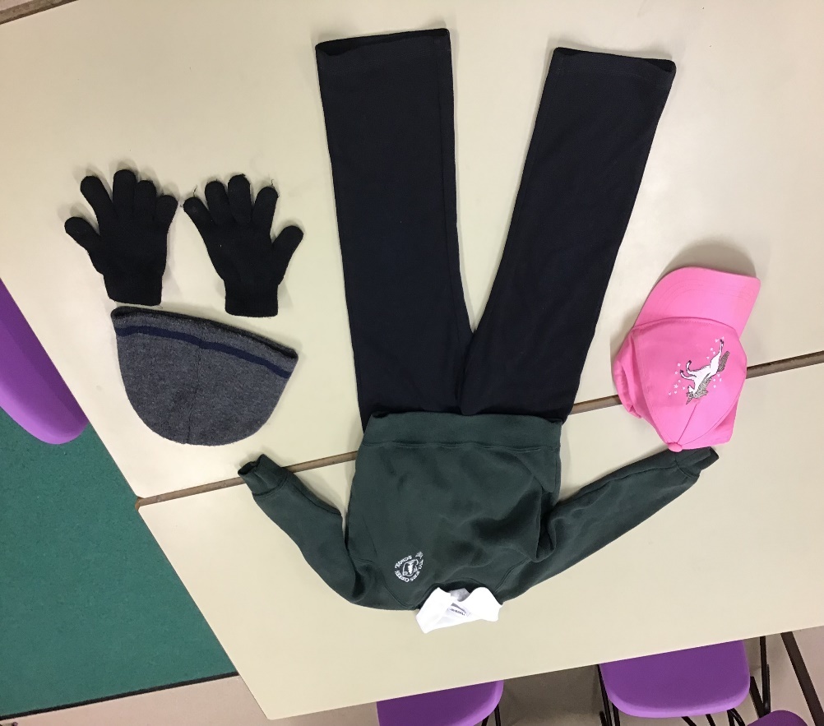
Our Uniform
Black jogging bottoms or leggings
White polo shirt
Bottle Green sweatshirt or cardigan
Sturdy black shoes that cover the whole foot (no laces please)
Wellies (to be kept in school)
No skirts, dresses or shorts please
Summer uniform
Black PE shorts to be kept in school for hot days
Sun hat
Waterproof coat
Suncream to be applied before school
Winter uniform
Warm waterproof coat every day
Hat & gloves (not scarves)
Warmer wellies (optional)
PLEASE NAME EVERYTHING!
PE Kit
Black shorts, white t-shirt, black plimsoles (in a bag)

Slide 12
School readiness
There has been lots of talk about this over the last couple of years and lots of misinformation about what 'school readiness' means. We would like children to be able to do the following. However, some of our children will be much younger and may need a little support to begin with:
Wipe their own bottom.
Put their coat on, including being able to pull the sleeves through.
Put their wellies and shoes on by themselves.
Take their sweatshirt off independently and pull the sleeves through.
Use a knife and fork to cut their food.
Listen to and follow simple instructions.
Be able to communicate their needs.
Share toys and take turns.
Understand why letters and numbers are important.
Be able to hold a pencil and have the necessary control to form recognisable letters.
Not all children will be able to do all of the above. Some, particularly the youngest children, will not be able to do the above highlighted in green. However, we do encourage them to practice these skills and would expect them to be at this stage by the end of the autumn term.

Slide 13
School readiness is not
Being able to read
Being able to write names or words using correct letter formation
Counting to 20
Never having toileting accidents
Sitting still on the carpet for more than 5 minutes
A checklist
One size fits all

Slide 14
Have a lovely summer.
Please remember that we are always here if you have any questions or anything that you’re concerned about. You can contact us through the office email or give us a call.
We look forward to meeting you all in September!

