Slide 1
Welcome to Reception at Tylers Green First School

Slide 2
Early Years Foundation Stage
from birth to end of Reception.
Prime areas of learning (the building blocks of Early Years):
personal, social & emotional development
communication & language
physical development
Specific areas of learning:
Literacy
Mathematics
understanding the world
expressive arts and design
At the end of Reception children are assessed against the 17 Early Learning Goals for the areas above. Children will be emerging or expected - at the level that we would expect at the end of Reception.

Slide 3
Our timetable
 | 8.40-8.50 | 8.50-9.10 | 9.10 – 10.15 | 10.15-10.45 | 10.45 – 11.45 | 11.45 – 1pm | 1-2.30 | 2.30 – 3.00 | 3.00
Monday | Name writing/self registration Mindfulness | Phonics | Reading activities | Playtime | Maths | Lunchtime | Fine motor, gross motor activities Name writing Phonics assessments | Story time | Get ready for home time.
Tuesday |  |  | Writing activities |  | Maths |  | Child initiated learning
Wednesday |  |  | Jigsaw |  | Music |  | Child initiated learning
Thursday |  |  | Reading activities |  | Maths |  | Child initiated learning
Friday |  |  | Writing activities |  | Maths |  | Child initiated learning

Slide 4
Our topics
Autumn
Spring
Summer
Let's Explore
Build It Up
Once Upon a Time
Puppets & Pop Ups
Focus stories – Where the Wild Things Are, There Is No Dragon In This Story.
Starry Night
Winter Wonderland
Ready Steady Grow
Signs of Spring
Focus stories – The Way Back Home, The Extraordinary Gardener
Animal Safari
Creep, Crawl & Wriggle
Big Wide World
Move It
Moving Up
Focus stories – The Lion Inside, Baby Goes to Market

Slide 5
Bits and Bobs
Class teddies – sent home on Fridays. Please don't do anything special. By halfway through the year we would like the children to be writing in the diaries. For now, a couple of photos or drawings from the children and a caption. The idea is to get the children talking in class about what they did at the weekend so please don't write lots.
Parents evenings – 10 minutes. We will update you on children's progress. If you have any concerns before then, please email the office and arrange a meeting with the class teacher.
PE will be on Mondays. We will need PE kits after Christmas but send in as soon as you have them – they can stay on pegs. We will need plimsolls after half term though for Nativity rehearsals.
Tapestry – if you haven't returned your forms yet, please do so. Any problems, email the office. Observations – you can put observations on there i.e. if there's a new baby, you've been to a wedding at the weekend etc. Please don't message us through Tapestry. Messages should be sent via e-mail.
Returning letters – please send any reply slips or important messages in childrens hands or hand them to us on the door. We don't have time to check book bags during the day.

Slide 6
How to help your child be successful in school
Be involved in your child's learning. Ask them what they learned at school today. Read our weekly newsletters. Come to workshops and meetings. Use Bug Club Phonics to practice sounds and read with your child every day.
Show them 'the why'. Children will be more successful if they understand why we are learning things. Why do we need to count? Why do we need to read?
Teach them that it's good to make mistakes – they help us learn. We don't expect children to get everything right every time. If they do, they're not learning anything new.
Play with them – through watching you, they will learn to share, take turns, understand that they won't always win/be first. You will teach them to persevere, be resilient and take risks. Know what they are watching on TV/internet and what games they are playing. Are they age appropriate? Young children are not able to distinguish between fantasy and reality – that's why there are age guidelines.
Read stories with them every day – not on a tablet or a phone but real books where you can have a conversation while you're reading. There are many studies that show that reading with your child every day helps to improve concentration, vocabulary, creativity, self esteem and knowledge.
Lead by example – children mimic adults. If they see you reading books, they will most likely develop a love of reading. If they see you with a phone in your hand all of the time, they will want to copy that too. They will want to join you in your hobbies and interests. Be a good example to your children.
Listen to them – they may not tell you what they did at school as soon as they come home but when they do, put down your phone, turn off the TV and listen

Slide 7
What did you do at school today?
When asked that question, most children will say 'nothing' or 'I played'. Many parents also say that when they ask their children who they played with they say 'nobody'.
All of the children are busy all day. We learn through play so everything that we do is a learning opportunity. Staff join in with play and we observe. If we notice any children who are playing by themselves, we will encourage them to join another child (although sometimes children want to play by themselves and that's ok too)
Often children have been so busy all day that when you ask what they did they feel overwhelmed and can't remember. They are also so happy to see you that you are all that they can think about.
Instead of asking them what they did, ask did they have a good day. On your way home, tell them something that you did today or tell them about someone that you talked to that day. Before you know it, they'll be telling you all about their day.
Have a look at our weekly newsletter. There is lots of useful information in there about what we're learning about for the week which you could ask the children about.
Look on Tapestry – a great prompt for children to tell you about their day.
Home time meltdowns - sometimes children's behaviour deteriorates at home when children start school. This can be because they are tired from learning new routines, making new friends and working hard at school. Please be patient. It usually passes within a few weeks. Do let us know though so we can try to do some extra work on self regulation strategies.

Slide 8
Reading books
Children will have access to books online (Bug Club) and a physical reading book
Each week we assess which sounds your child knows. Children should be reading books with sounds and tricky words that they know so we would not allocate books to them if they do not recognise those sounds and/or tricky words yet. We will constantly reassess and change book allocations accordingly.
We will also be sending a book home from school each week for your child to share with you. Again, please look at the suggestions at the beginning and end of the book and feel free to re-read the book several times. The books that we send home will include sounds that your child recognises. Please continue to play the games on Bug Phonics to learn all of the sounds that we have introduced. Some children will take longer to learn the sounds. Please focus on a few sounds at a time.

Slide 9

Bug Phonics
Each week we will allocate games to practice sounds that we have introduced that week
We will also allocate books to practice the sounds that we are learning
Children should spend around 10 minutes on Bug Phonics each day, either playing a game or reading some of a book. Please don’t feel that you need to read a whole book all in one go. Some children will be able to but others may need to read one page at a time. You know your child best so please go at their pace.
Look at the first page – there are lots of ideas here for how to read the book such as the sounds that the book will focus on, any tricky words and comprehension.
Click on the Bug for an extra game.
Each book can be re-read several times. Each time, focus on something different – word reading, comprehension, looking for individual sounds or tricky words etc. The Reading Framework, published last year, recommends that children should re-read books to increase fluency: ‘Re-reading a text, therefore, gradually increases the number of words in it that they can read ‘at a glance’.
There are further follow-up ideas on the last page of the book.

Slide 10
How you can help with reading/writing at home
Give your child plenty of opportunities to write at home:
Write birthday/Christmas cards
Ask for help when reading/writing a shopping list
Write letters to grandparents or friends
Have notepads, post-it notes
Ask for help to label things (food, toys etc)
Magnetic boards and magnetic letters
Phonics games to practice segmenting (listening for the sounds in words)
Read and write in front of them – children will always copy grown ups
Don’t correct phonetic spelling. If your child has written bread as ‘bred’, that is phonetically correct. There is plenty of time for learning spellings later on. Your child may not be able to hear all of the sounds in a word yet so they may write the word bread as ‘bed’ ‘bd’ or ‘b’. If they can’t hear all of the sounds, try saying them together. Hold up 3 fingers, let’s see if we can hear 3 sounds in this word.
Lots of praise for having a go at reading and writing!
Try to encourage correct letter formation and capitals only at the beginning of a sentence or for names. It is very difficult to ‘unteach’ incorrect letter formation.

Slide 11
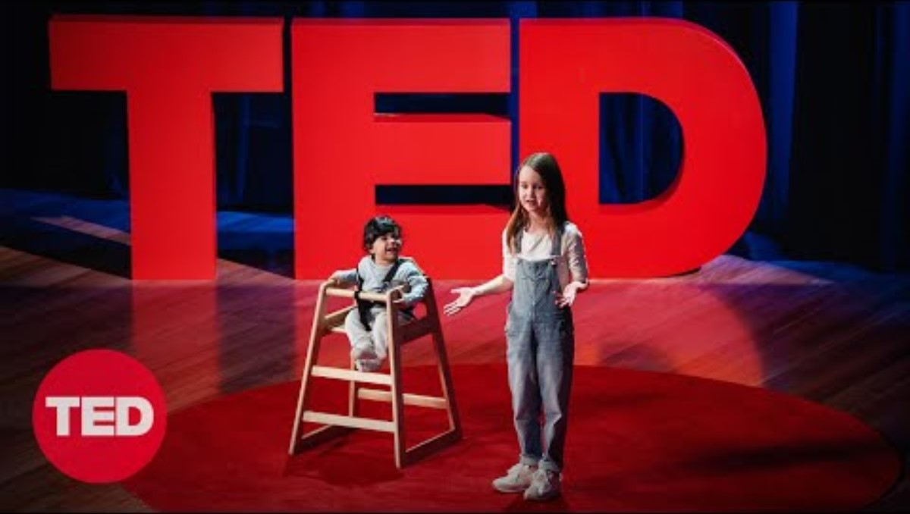

Slide 12
Please keep in touch
Please let us know if there are any changes in circumstances at home that may affect your child i.e. mum is away all week for work, a death or illness in the family etc.
Come and talk to us if you have any questions or concerns. At pick up is the best time to talk as we are usually busy trying to settle the children in the mornings and start phonics. Or you can email the office with your question or to arrange a meeting or phone call. Do not send messages on Tapestry if you want a quick reply. We don't have time to check messages during the day. If you email the office, Mrs Turner will make sure that we get urgent messages.
Tea time - if your child isn't going to tea time or another after school club, please let us know (either when you drop off in the morning or email school). We are not on the tea time WhatsApp group so do not see their messages.

