Slide 1
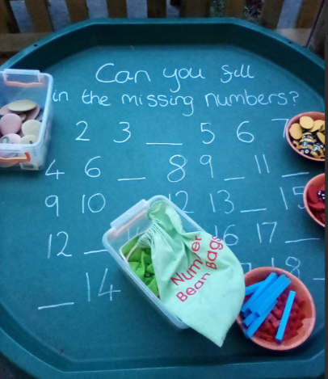
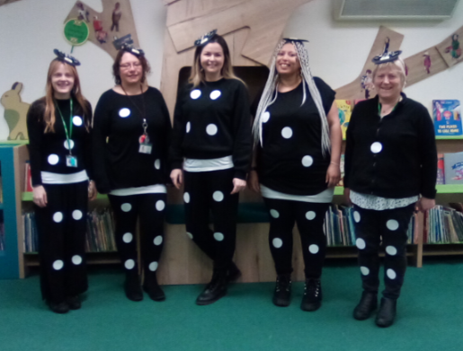
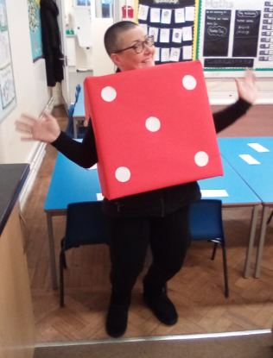
Maths at Tylers Green First School
“It’s different from when I did it at school!”

Slide 4
All maths lessons are planned and taught to include all of these elements in each lesson.

Slide 6
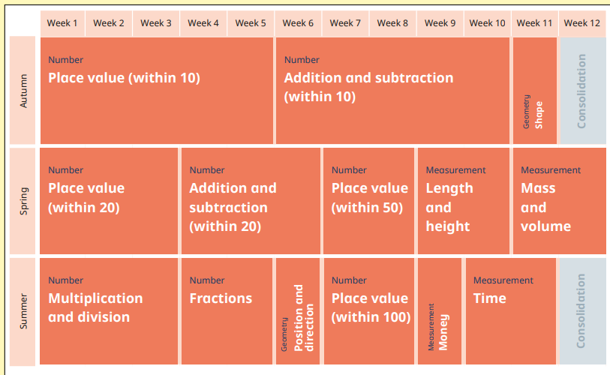

Slide 7
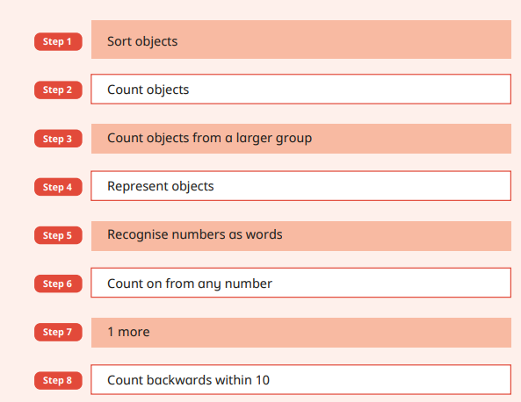
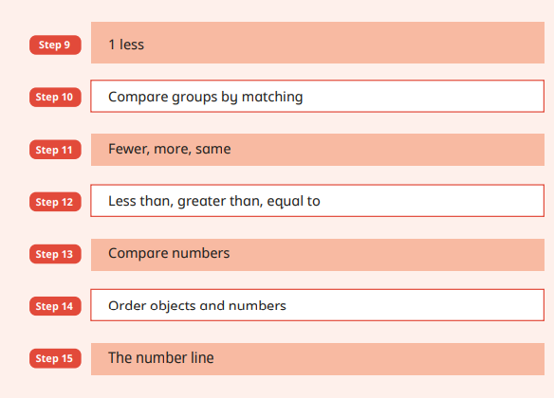

Slide 8
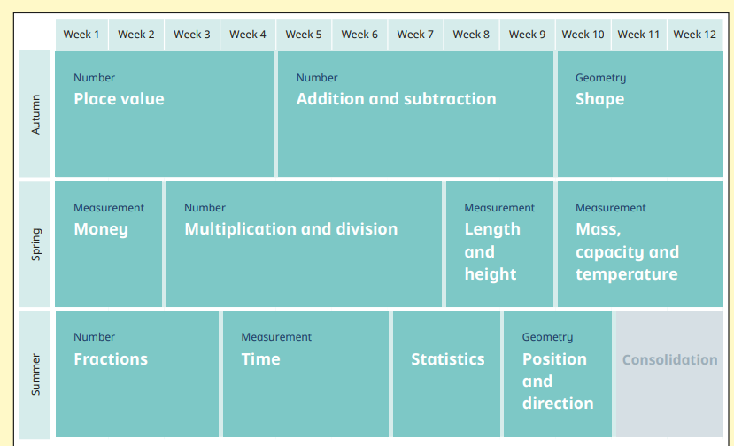

Slide 9
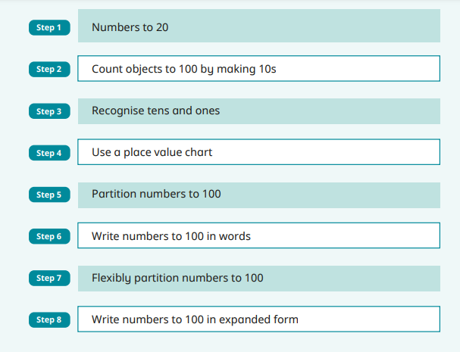
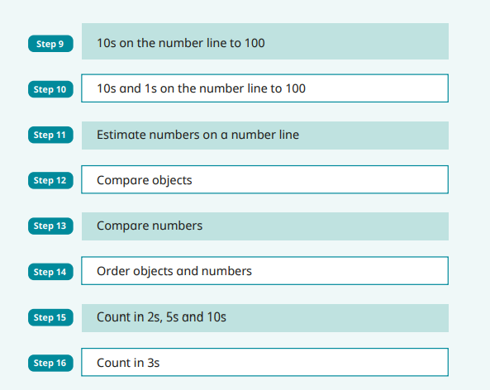

Slide 10
Daily retrieval practice.....

Slide 12
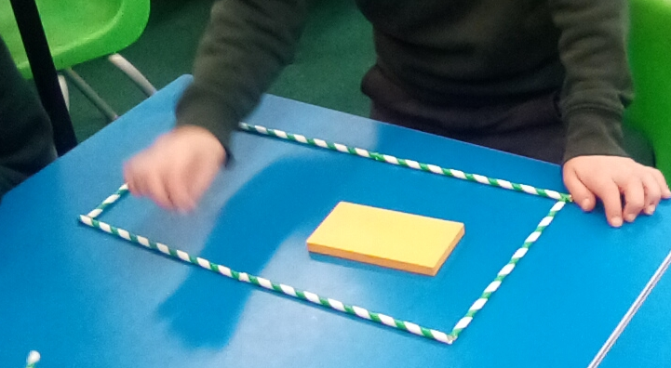
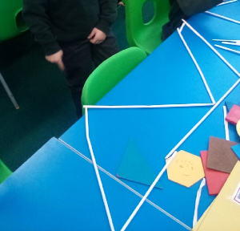
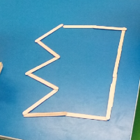
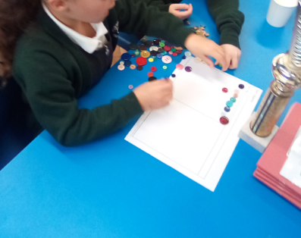
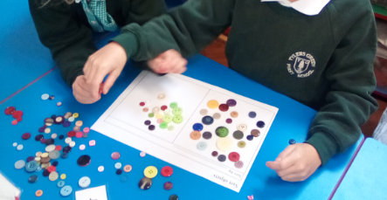
Concrete.....

Slide 15
5
35
Reception
Year 1

Slide 17
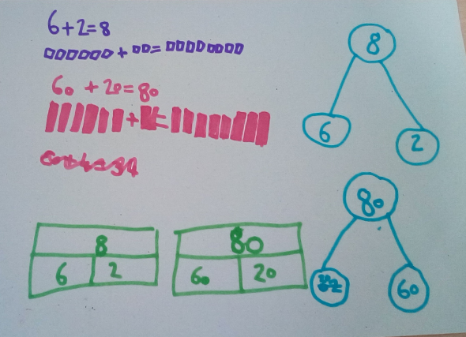
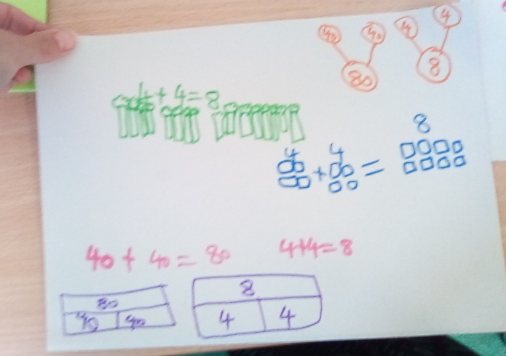

Slide 18
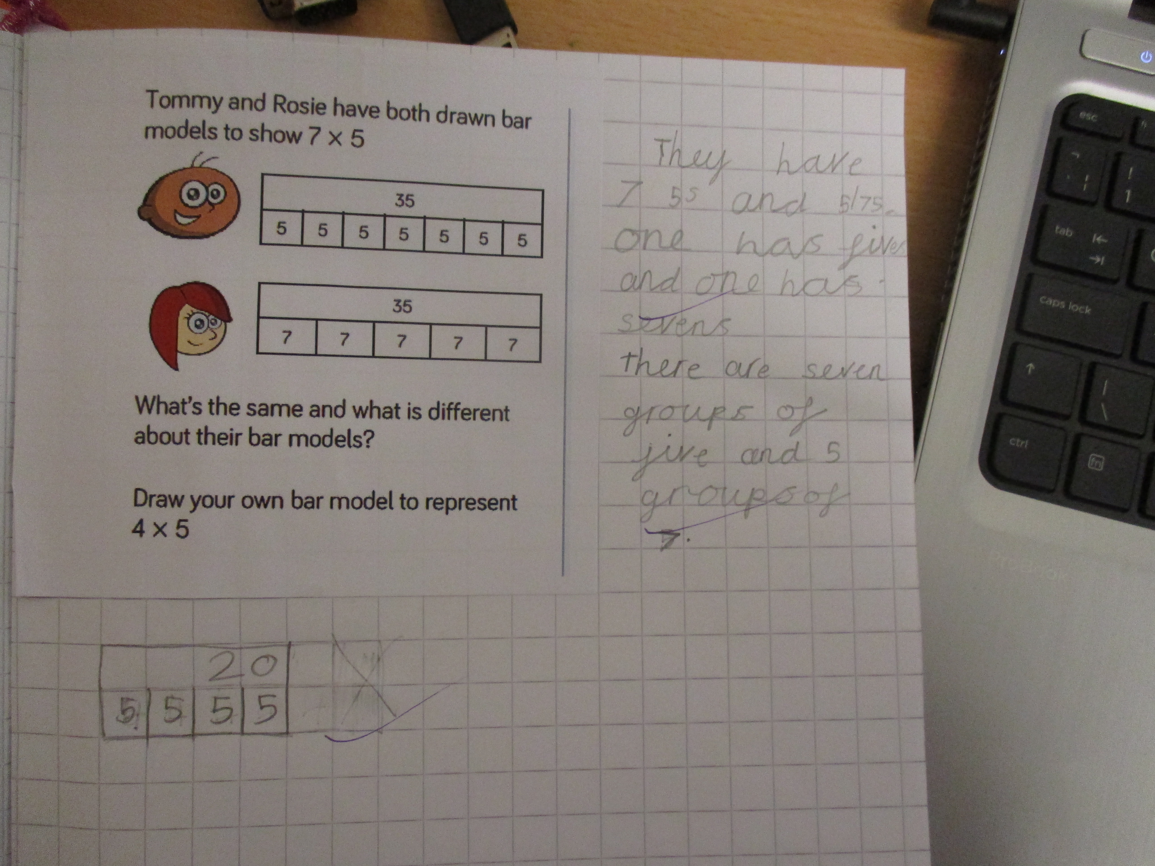
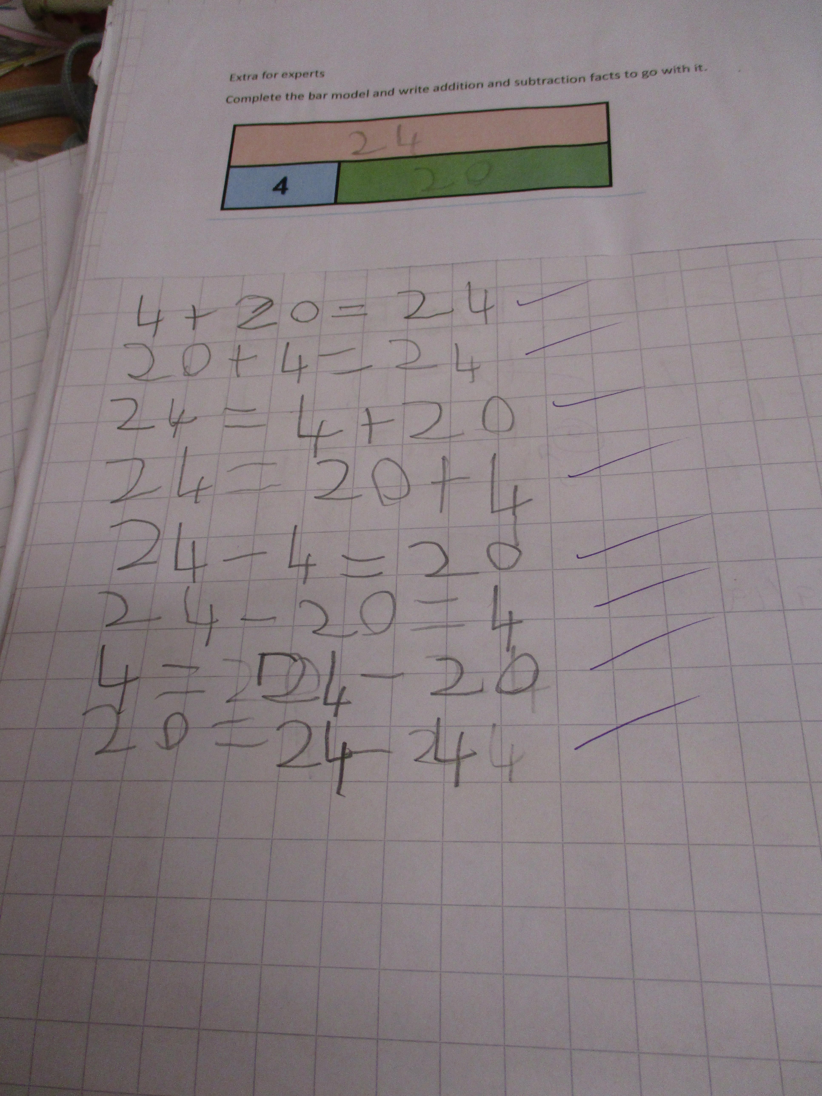

Slide 19
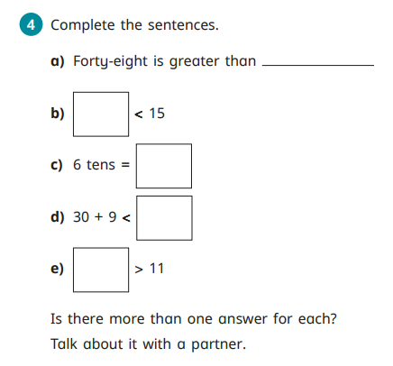
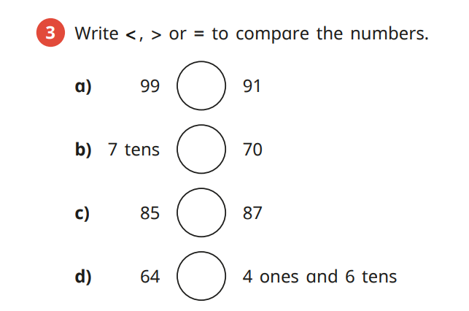
Abstract.....
Year 2 Autumn term
Year 1 Summer term...

Slide 20
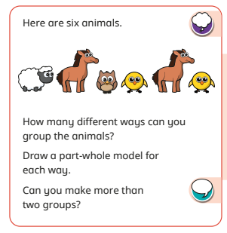
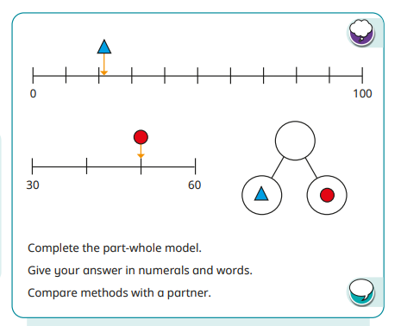
Some examples of Problem Solving and Reasoning
Year 1 Autumn
Year 2 Autumn

Slide 21
Questions that extend reasoning and problem solving...
Is there another way??
How do you know?
What do you notice about.....?
Why is this wrong?
Explain the rule.
Why didn't you....?
Represent this another way.
What's missing?
Write your own question to explain the concept.
How could we check this?

Slide 22
Assessment Year 1
Teachers assess daily!
3 other assessment points in the Year-
Autumn (November/December)
Spring (March)
Summer (July)
Teachers track progress from start of year to end)

Slide 23
Assessment Year 2
Autumn and Spring Assessment points in November and March using NFER.
Teachers track progress across the Year.

Slide 24
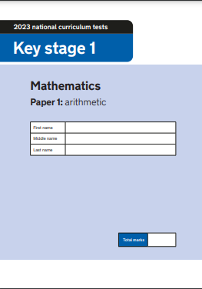
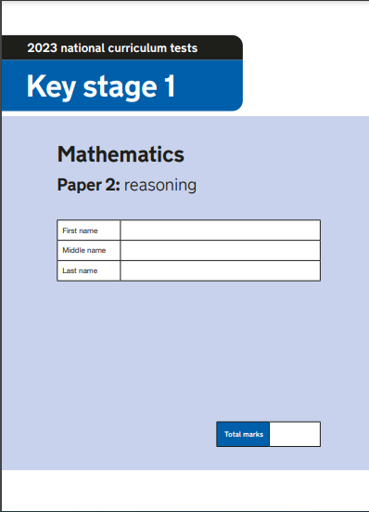
SATS are no longer statutory in KS1- however they are a very good marker of progress across the year.
We can also compare nationally.
All "Quizzes" are carried out in class and in a non- scary manner!
Progress is measured by Standardised scores in quizzes as well as constant Teacher Assessment in lessons.

Slide 25
Y2 Teacher Assessment Framework-
There are 3 standards the children can be by the end of Year 2.
Working towards the standard.
Working at the standard.
Working at Greater Depth.

Slide 26
How can you help at home??
5 minutes a day will really help with fluency.
We can adjust the settings! We can make it faster or slower.
You are allowed to type in your child's answer!

Slide 27
Other ways to help at home....
Board games- these are fantastic for different maths skills such as number recognition and addition and subtraction.

Slide 28
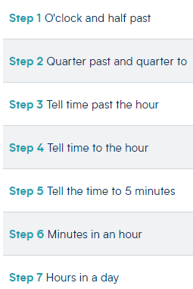
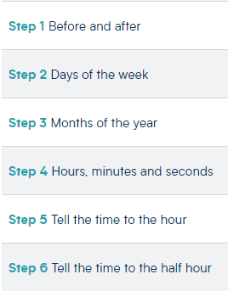
Maths topics that are life skills!
Time!
Year 2
Year 1

Slide 29
Money
Coin and note recognition
Combining to make different amounts
Making the same amount in different ways.
Finding Change

Slide 30
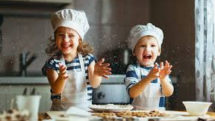
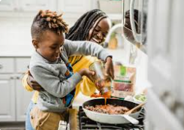
Weighing and measuring.
Reading scales at different intervals is a Year 2 objective.

Slide 31
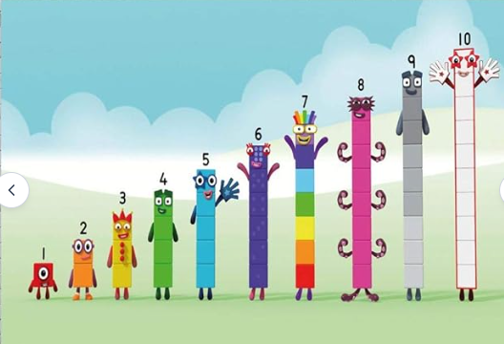

Slide 32
Now it's your turn!!
Any Questions please come and ask! Thank you for coming!

