Slide 1
Welcome to Reception at Tylers Green First School

Slide 2
Early Years Foundation Stage
from birth to end of Reception.
Prime areas of learning (the building blocks of Early Years):
personal, social & emotional development
communication & language
physical development
Specific areas of learning:
Literacy
Mathematics
understanding the world
expressive arts and design
At the end of Reception children are assessed against the 17 Early Learning Goals for the areas above. Children will be emerging or expected - at the level that we would expect at the end of Reception.

Slide 3
Our timetable
 | 8.40-8.50 | 8.50-9.10 | 9.10 – 10.15 | 10.15-10.45 | 10.45 – 11.45 | 11.45 – 1pm | 1-2.30 | 2.30 – 3.00 | 3.00
Monday | Name writing/self registration Mindfulness | Phonics | Sound of the day | Playtime | Maths | Lunchtime | Fine motor, gross motor activities Name writing Phonics assessments | Story time | Get ready for home time.
Tuesday |  |  | Sound of the day |  | Maths |  | Child initiated learning
Wednesday |  |  | Jigsaw |  | Music |  | Child initiated learning
Thursday |  |  | Sound of the day |  | Maths |  | Child initiated learning
Friday |  |  | Sound of the day |  | Maths |  | Child initiated learning

Slide 4
Our topics
Autumn – all about me
Spring – woodland animals
Summer - growing
Me
My family
My school
My body
Likes and dislikes
Rights and responsibilities
Foxes, hedgehogs, owls, birds, squirrels, rabbits, mice
Facts about our woodland animals
Fiction books
Lots of science & nature
Grow vegetables, flowers
Life cycles
Lots of science & nature
Transition to Year 1 – thinking about what we've learned and what we will learn next year.

Slide 5

Bug Phonics
Each week we will allocate games to practice sounds that we have introduced that week
We will also allocate books to practice the sounds that we are learning
Children should spend around 10 minutes on Bug Phonics each day, either playing a game or reading some of a book. Please don’t feel that you need to read a whole book all in one go. Some children will be able to but others may need to read one page at a time. You know your child best so please go at their pace.
Look at the first page – there are lots of ideas here for how to read the book such as the sounds that the book will focus on, any tricky words and comprehension.
Click on the Bug for an extra game.
Each book can be re-read several times. Each time, focus on something different – word reading, comprehension, looking for individual sounds or tricky words etc. The Reading Framework, published earlier this year, recommends that children should re-read books to increase fluency: ‘Re-reading a text, therefore, gradually increases the number of words in it that they can read ‘at a glance’.
There are further follow-up ideas on the last page of the book.

Slide 6
Reading books
Children will have access to books online (Bug Club) and a physical reading book
Each week we assess which sounds your child knows. Children should be reading books with sounds and tricky words that they know so we would not allocate books to them if they do not recognise those sounds and/or tricky words yet. We will constantly reassess and change book allocations accordingly.
We will also be sending a book home from school each week for your child to share with you. Again, please look at the suggestions at the beginning and end of the book and feel free to re-read the book several times. The books that we send home will include sounds that your child recognises. Please continue to play the games on Bug Phonics to learn all of the sounds that we have introduced. Some children will take longer to learn the sounds. Please focus on a few sounds at a time.

Slide 7
How we teach reading
During the Autumn term, reading is taught through our phonics and ‘sound of the day’ lessons. From January we will have reading and writing lessons each week. Children will then have:
Shared reading with teachers twice a week (whole class) – we teach word reading, inference, prediction, retrieval, sequencing and vocabulary using characters to help children remember the skills.
Guided reading with teachers twice a week in small groups
Individual reading with our teaching assistants or teacher each week for children who need extra practice.
Some children will not keep up with the pace at which we teach phonics. They will take part in extra group work with their teacher or TA. They will play phonics games and/or have extra reading opportunities during the week. We may also send some games/activities home to support the children.

Slide 8
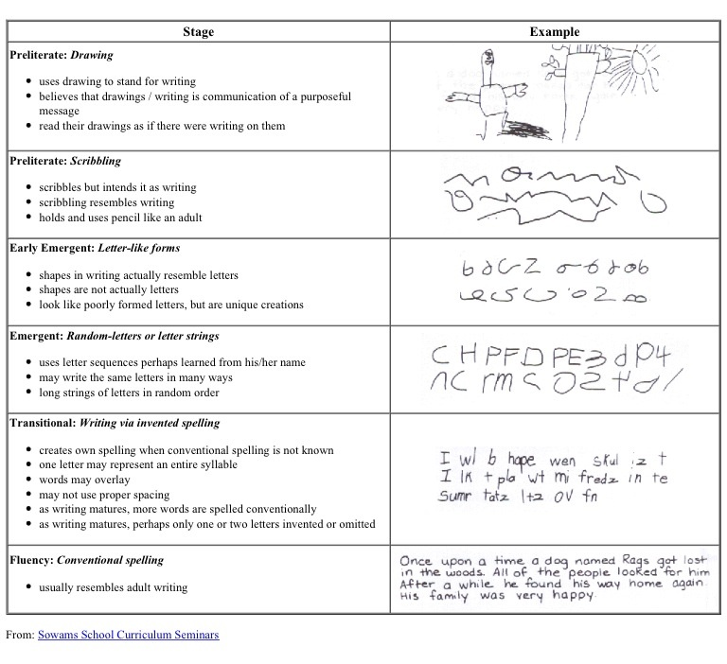
Early Writing

Slide 9
How we teach writing
In the Autumn term we practice writing names, using the correct letter formation and a capital letter at the beginning.
During phonics we use whiteboards to practice writing words containing the sounds that we are learning and tricky words.
We also use magnetic letters and boards for children who find letter formation tricky.
We provide lots of opportunity to develop fine motor skills.
Each area in school has opportunities for children to write independently whilst engaged in child initiated learning (include photos)

Slide 10
How we teach writing
From January we begin more formal writing lessons each week:
We usually start by reading a book related to our topic or a Bug Phonics book.
The book will then lead to a writing opportunity. For example, when reading ‘The Hedgehogs Balloon’ we then think of words to describe the noise that a balloon makes when it bursts.
Childrens writing ability varies hugely in Reception. Some children are beginning to write simple sentences and others are not hearing any sounds in words. We will always teach to your childs ability.
For each word, we encourage children to hear 3 sounds (beginning, middle and end). As they become more confident we encourage them to listen for more sounds.
We use prompts on the table so children can look at correct letter formation and find tricky words to ensure correct spellings.
Our aim, by the end of the year, is for all of the children to be able to write sentences independently.

Slide 11
How you can help at home
Give your child plenty of opportunities to write at home:
Write birthday/Christmas cards
Ask for help when writing a shopping list
Write letters to grandparents or friends
Have notepads, post-it notes
Ask for help to label things (food, toys etc)
Magnetic boards and magnetic letters
Phonics games to practice segmenting (listening for the sounds in words)
Write in front of them – children will always copy grown ups
Don’t correct phonetic spelling. If your child has written bread as ‘bred’, that is phonetically correct. There is plenty of time for learning spellings later on. Your child may not be able to hear all of the sounds in a word yet so they may write the word bread as ‘bed’ ‘bd’ or ‘b’. If they can’t hear all of the sounds, try saying them together. Hold up 3 fingers, let’s see if we can hear 3 sounds in this word.
Lots of praise for having a go at writing!
Try to encourage correct letter formation and capitals only at the beginning of a sentence or for names. It is very difficult to ‘unteach’ incorrect letter formation.

Slide 12
Maths
Mastering maths means pupils of all ages acquiring a deep, long-term, secure and adaptable understanding of the subject. The phrase ‘teaching for mastery’ describes the elements of classroom practice and school organisation that combine to give pupils the best chances of mastering maths. Achieving mastery means acquiring a solid enough understanding of the maths that’s been taught to enable pupils to move on to more advanced material.
Concrete – using physical objects to solve mathematical problems
Pictorial – using drawings to solve mathematical problems
Abstract – solving maths problems using only numbers
In school we teach one number each week. We usually start the week by watching the Numberblocks episode related to the number. Whilst focusing on each number we will be:
Learning to recognise and write the number
Finding different ways to make that number (addition and subtraction)
Looking at shapes with that number of sides, corners or points and finding them in the environment
Our maths activities are often outside and we use natural resources such as conkers, pine cones and stones to make representations of numbers.
As the year goes on, we will begin doubling, halving, sharing and problem solving

Slide 13
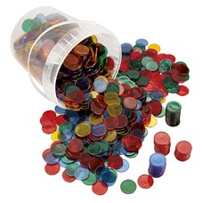
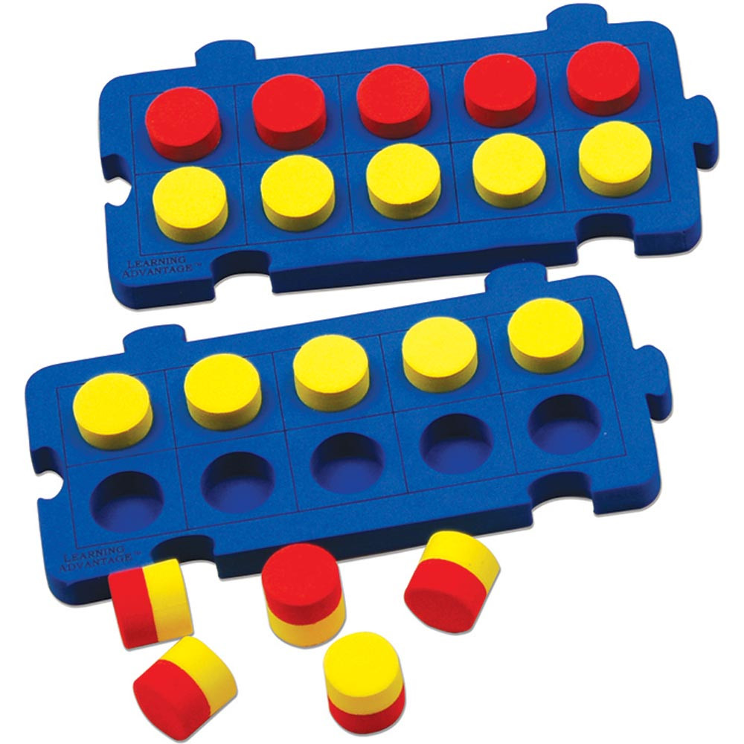
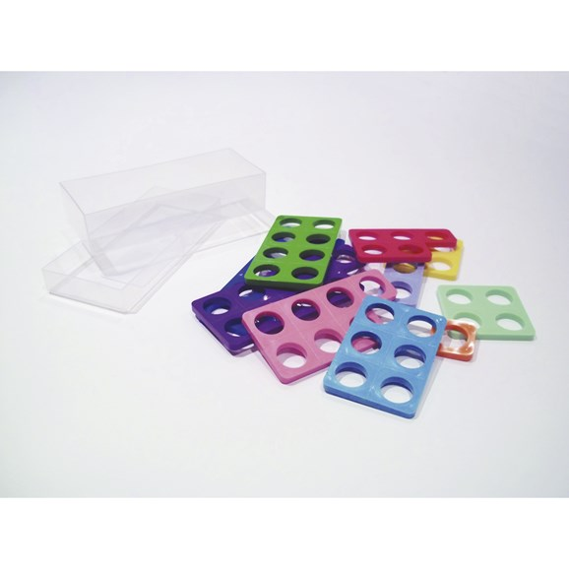
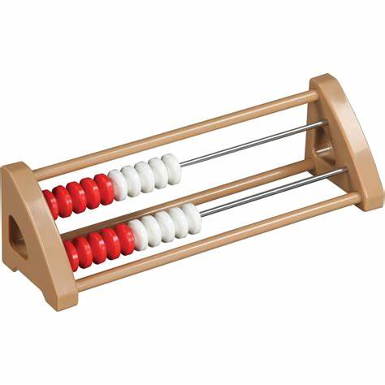
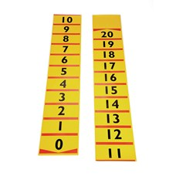
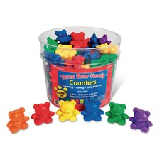
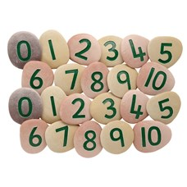
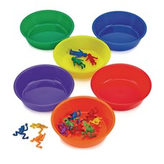
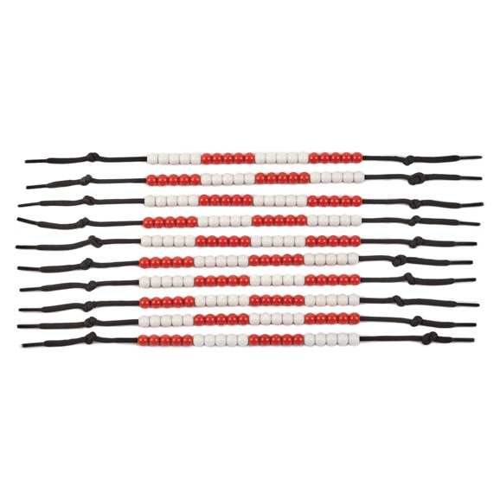
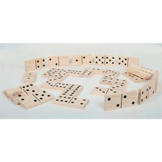
Our maths resources
Rekenrek
Tens frame
Numicon
Counting beads

Slide 14
How to help your child be successful in school
Be involved in your child's learning. Ask them what they learned at school today. Read our weekly newsletters. Come to workshops and meetings. Use Bug Club Phonics to practice sounds and read with your child every day.
Show them 'the why'. Children will be more successful if they understand why we are learning things. Why do we need to count? Why do we need to read?
Teach them that it's good to make mistakes – they help us learn. We don't expect children to get everything right every time. If they do, they're not learning anything new.
Play with them – through watching you, they will learn to share, take turns, understand that they won't always win/be first. You will teach them to persevere, be resilient and take risks. Know what they are watching on TV/internet and what games they are playing. Are they age appropriate? Young children are not able to distinguish between fantasy and reality – that's why there are age guidelines.
Read stories with them every day – not on a tablet or a phone but real books where you can have a conversation while you're reading. There are many studies that show that reading with your child every day helps to improve concentration, vocabulary, creativity, self esteem and knowledge.
Lead by example – children mimic adults. If they see you reading books, they will most likely develop a love of reading. If they see you with a phone in your hand all of the time, they will want to copy that too. They will want to join you in your hobbies and interests. Be a good example to your children.
Listen to them – they may not tell you what they did at school as soon as they come home but when they do, put down your phone, turn off the TV and listen

Slide 15
